Slide 1

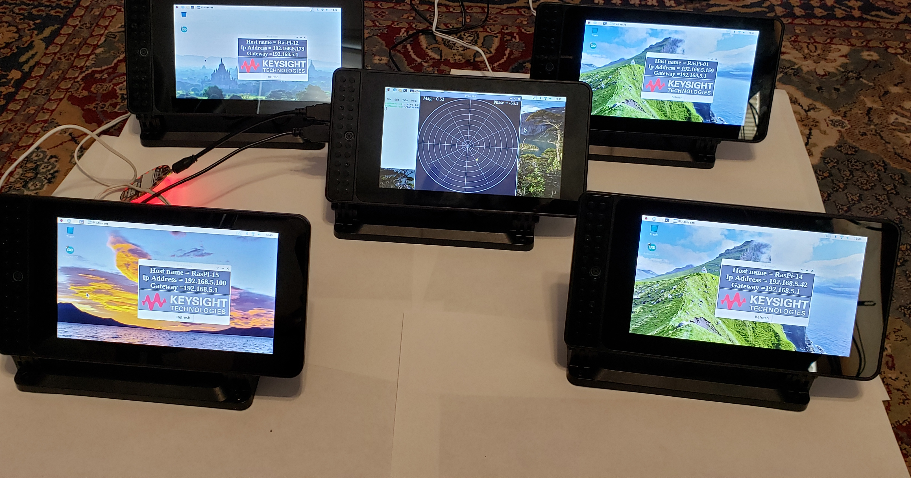
Colorado Hack-a-Thon February 22nd and 23rd
Keysight Pi Kits

Slide 2
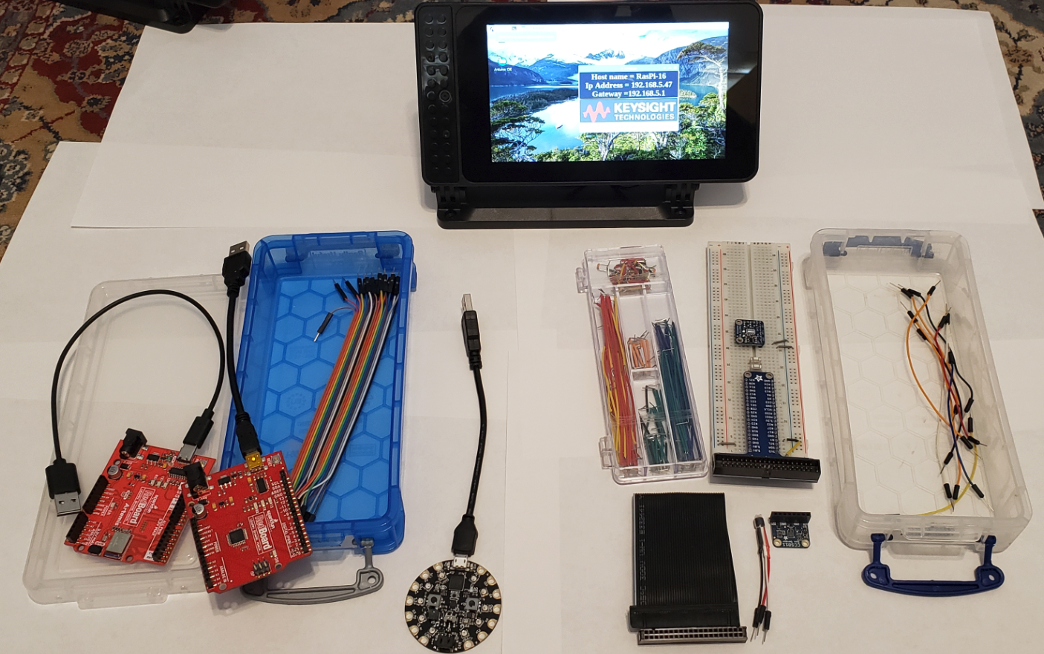
Raspberry Pi + Smarti-Pi Case Standard kit and Circuit explorer kit.
Standard Kit
Circuit Playground
SparkFun Redboard
SparkFun Artemis
20 wire bundle Male-Male
Circuit Explorer Kit
Proto-board wire kit
Pi to Protoboard adapter
MLP3115A – I2C pressure sensor
CSC811 – Air Quality Sensor
TMP36 – Analog Temperature
2 buttons

Slide 3
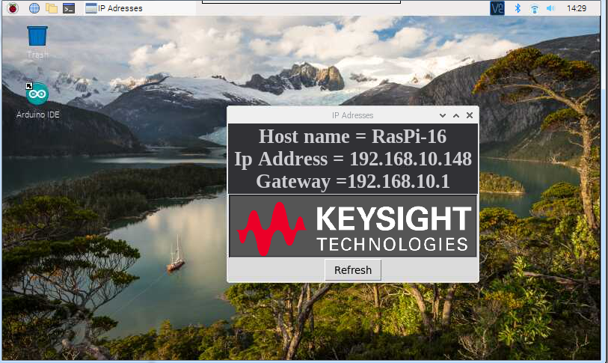
Basic Tour of the Raspberry Pi
On power up:
This will show the Host name and IP address once it is connected to a network. This can be closed at any time

Slide 4
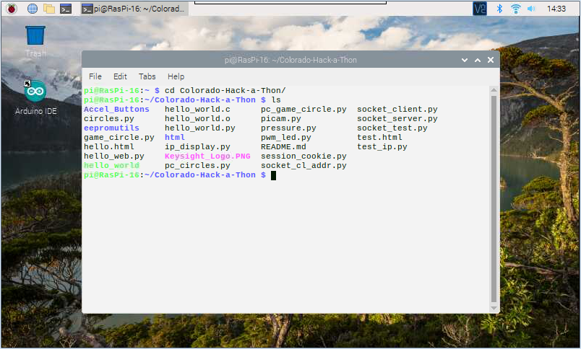
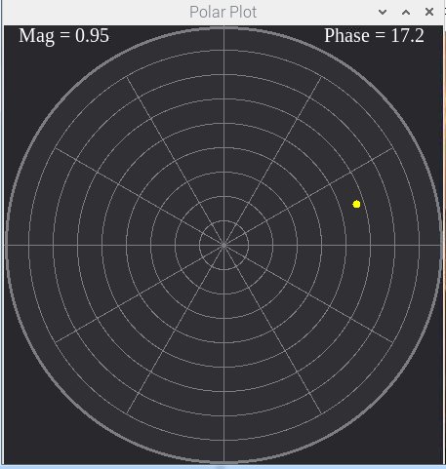
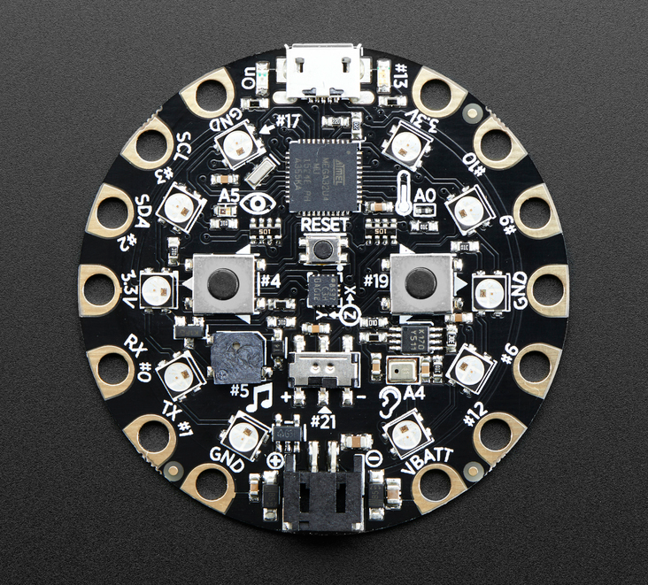
Tour open terminal
Change directory to the Colorado-Hack-a-Thon folder
Type: python picam.py - The camera should start up
Plug in the round circuit board, “Circuit Playground” to a USB port. Then type: python game_circle.py Notice what happens when the marker gets to the center.

Slide 5
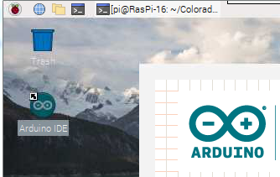
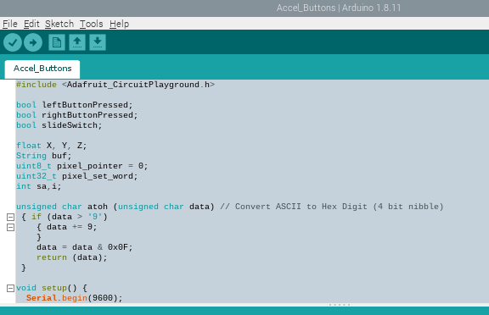
Look at Arduino Programming
Close the game_circle program if running.
Double click the Arduino IDE on the desktop.
This is the program loaded into the Circuit Playground

Slide 6
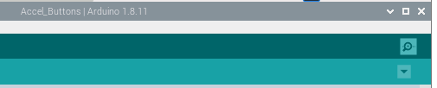
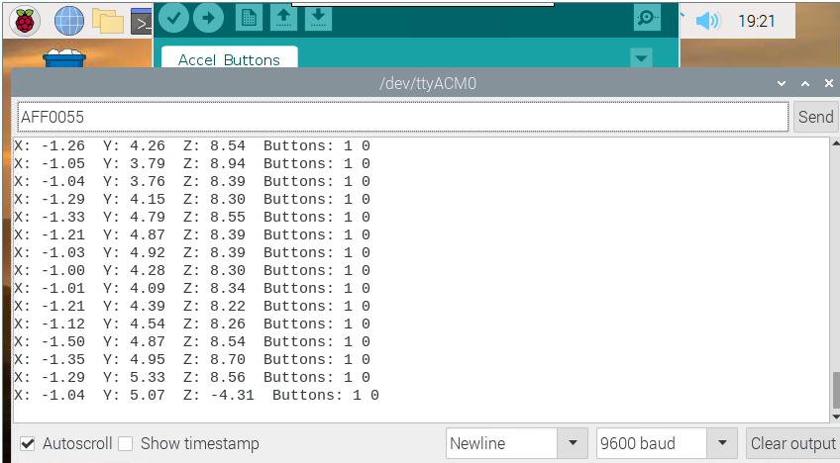
Look at serial monitor
Click to open monitor
Enter LED# + RGB code
Serial data coming to the Pi

Slide 7
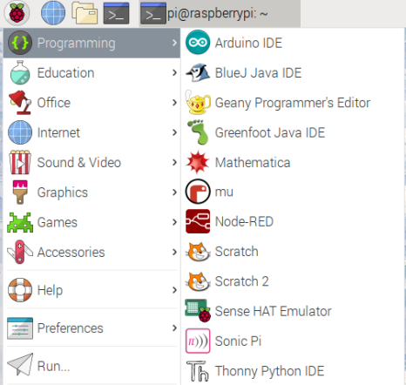
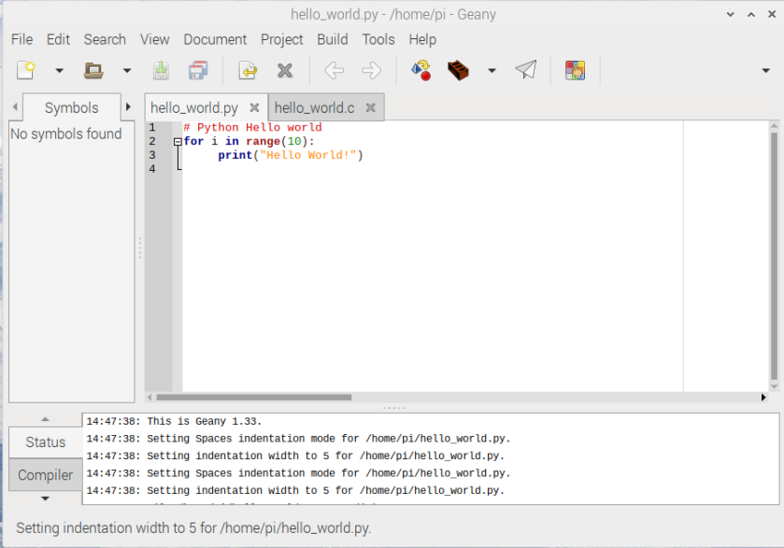
Geany – A Raspberry Pi IDE
Change the code, save and run it.

Slide 8
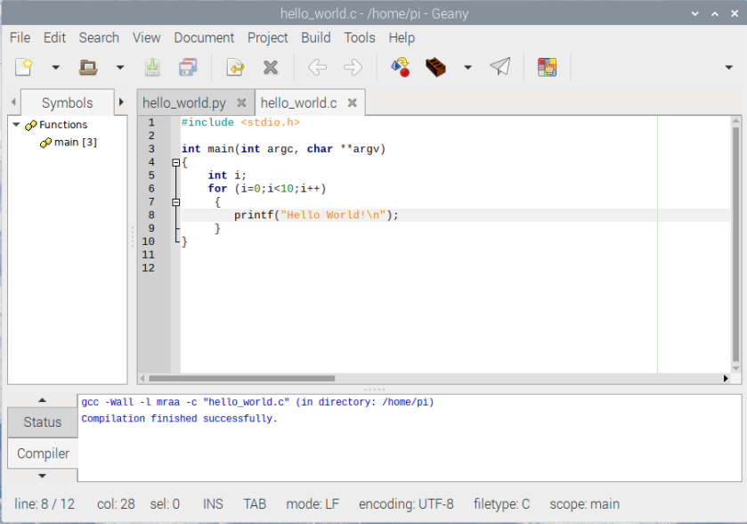
Geany and C programming
Compile the code
Build the code
Then Run it

Slide 9
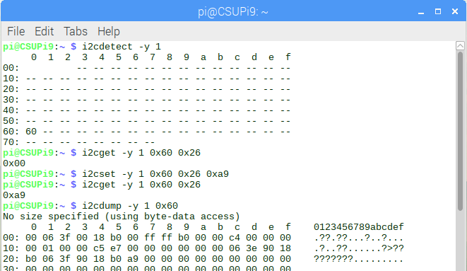
Handy Tools I2C
The i2c bus is a bidirectional bus with 2 lines SDA and SCL.
This bus can have up to 117 devices.
i2cdetect - Show the devices on an i2c bus
i2cget – read a register value from an i2c device
i2cset – write a value to an i2cdevice.
i2cdump – dump all the values available from an i2cdevice.

Slide 10
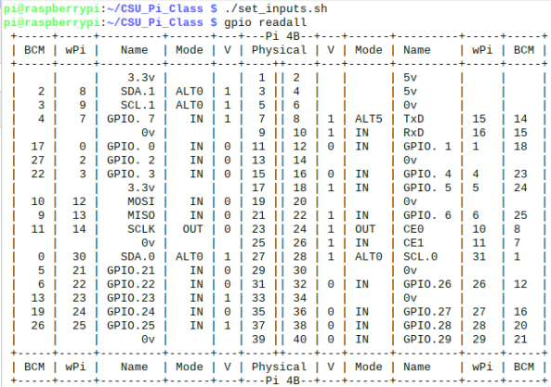
Handy Tools GPIO
In a terminal in the Colorado-Hack-a-Thon folder
Type ./set_inputs
gpio readall

